Slide 1

Multi-Source Data Integration Pipeline
DATA SCIENCE REVIEW-2
 | Under the Guidance of Dr. N SUNANDA Department of Computer Science and Engineering, KLH CSE Bowrampet Campus
Team Members Name: K.Sahasra-2420030068 : K. Navya-2420030180 :K. Bhavya Sri-2420030181

Slide 2

Outline of Project Work
Focus
Introduction
Literature Survey
Challenges
Research Objectives
Conclusion & Future Work
References
Publications Details

Slide 3
Problem Statement
Nowadays, data is collected from many different sources like:
Excel files
Databases
Websites
Online applications
The main problem is that all these sources store data in different formats.
Because of this, it becomes difficult to:
Combine the data
Clean the data
Analyze the data
Use the data effectively
Our project Multi-Source Data Integration Pipeline solves this problem by combining data from different sources into one system.

Slide 4
Objectives
To develop a pipeline for collecting data from multiple sources.
To integrate data from different sources into a single system.
To implement data cleaning and transformation techniques.
To construct a common database with clean and integrated data.
To remove duplicate records and handle missing values.
To improve data quality and reduce manual work.
To support reporting, visualization, and decision-making.

Slide 5
Literature Survey
Authors | Title of the Paper | Methodology | Inferences | Limitation/Future work
Marek Macura (2014) | Integration of Data from Heterogeneous Sources Using ETL Technology | Uses ETL and wrapper layer to integrate heterogeneous data sources | ETL helps convert different source data into a common form for analysis | Handling heterogeneous sources and achieving uniform data remains challenging
Manel Souibgui et al. (2019) | Data Quality in ETL Process: A Preliminary Study | Focuses on data quality checking during ETL from internal and external sources | ETL can handle heterogeneous data, but data-quality problems need to be tracked during the process | ETL can be complex and time-consuming when data has different quality problems
Chen Ye et al. (2023) | Multi-Source Data Repairing: A Comprehensive Survey | Studies duplicate detection, conflict resolution and inconsistency repair in multi-source data | Multi-source data can contain duplicate, conflicting and inconsistent information | More research is needed for combined/complex data errors and multi-source data repair
I Made Putrama & Péter Martinek (2024) | Heterogeneous Data Integration: Challenges and Opportunities | Reviews different heterogeneous data integration approaches, including ETL, databases and semantic methods | Data integration is difficult because of different formats, structures and semantics | More work is needed for unstructured/semi-structured data and semantic integration

Slide 6
Problem Gap Identification
Data is coming from different sources like Excel files, databases, websites, and online applications.
These sources have different formats, so combining the data is difficult.
Data can have missing values and duplicate records, which reduces data quality.
Cleaning and combining data manually takes more time and effort.
Existing approaches focus on different parts of data integration, but there is a need for a single pipeline that handles the complete process.
Therefore, our project aims to collect, clean, transform, and integrate multi-source data into one database for easy analysis.

Slide 7
Innovation, Creativity, and Novelty
Innovation
Integrates data from multiple sources into one system.
Provides a complete data integration pipeline from collection to database.
Improves data quality by handling missing values and duplicate records
Creativity
Uses a step-by-step pipeline: Collect → Clean → Transform → Integrate.
Converts different source data into a common format.
Makes the integrated data easy to use for reporting and visualization.
Novelty
Combines data collection, cleaning, transformation, and integration into one workflow.
Reduces manual work by bringing the complete process into a single system.
Provides one clean and integrated database for analysis and decision-making.

Slide 8
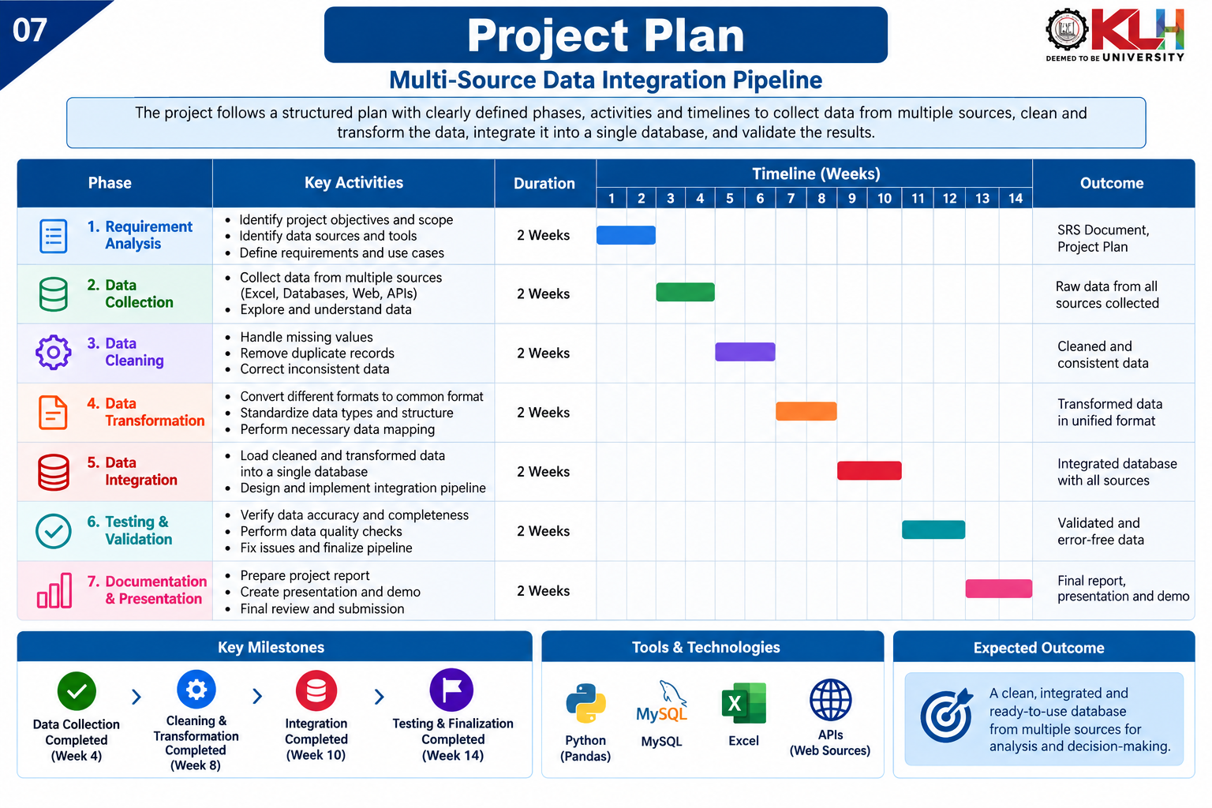
Feasibility and Project Plan

Slide 9
